Slide 1
Finocracy
July 2018
Deep Data Analytics : ML & AI
PoC

Slide 2



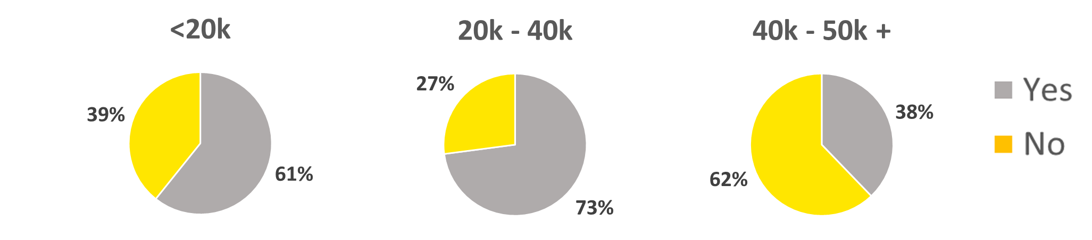


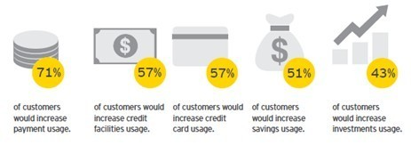
Executive Dashboard
Who Are Your top 10 Customers?
What did the customers value?
Product Details
Mass
Emerging Affluent
Affluent
Would You Switch to a bank with better Digital Services? – Income Breakdown
Product performance
Age: 35
Gender: Female
Monthly salary: 10-20k AED
Products: Libshara account; Credit Card
Digital engagement: Lower
Age: 29
Gender: Male
Monthly salary: 20-50k AED
Products: Libshara account; Credit Card; Loan (personal/car)
Digital engagement: Higher
Age: 40
Gender: Male
Monthly salary: > 50k AED
Products: Libshara Current and Saving Account; Credit Card; Car loan Mortgage
Digital engagement: Low-medium
Libshara Account usage
Standing Order setup
Credit Card usage
How quickly would you be prepared to switch to a Digital only Bank?
40%
60%
50%
Prospect customers
Active customers
Customers – Choice to Express
Benefits
How relevant is your Bank to your life, Helping you achieve your goals?
Improving the digital customer experience could deliver significant uplift across:
Do you want your deposits to be utilized by the bank for a good social cause
AVG
AVG
Not Relevant
Extremely Relevant
0%
100%
60%
67%
39%
46%
Performance of Community events
Where do you want the bank to utilize your deposits ?
AVG
AVG
of customers would increase payment usage
of customers would increase credit card usage
of customers would increase savings usage
of customers would increase investment usage
Failure
Success
Construct house / orphanage / hospitals for poor
Disagree (0)
Agree (10)
Community Event 1
65%
74%
Finance business for low income group
6.7
7.1
AVG
Disagree (0)
Agree (10)
Community Event 2
Failure
Success
6.7
9.1
65%
90%

